Slide 1
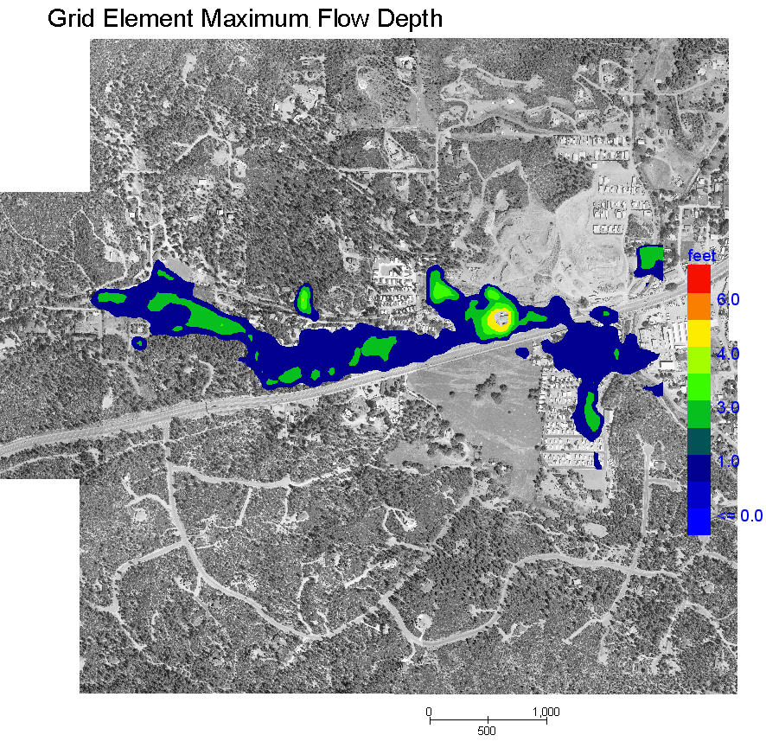
Unconfined Floodway Delineation
Jim O'Brien
FLO-2D Software, Inc.

Slide 2
Typical Floodway Approach
Reserve unobstructed channel area for 100-yr flood conveyance.
Separate floodway and floodway fringe zones (no conveyance in floodway fringe)
Pass 100-yr flood without raising WS elevation 1 ft
Equal conveyance reduction on each side of channel

Slide 3
HEC-RAS Floodway Concerns
Flood conveyance does occur in the fringe and floodwave attenuation will affect floodway
Conveyance and WS elevations on different on each river bank
Fringe development forces volume downstream
Floodway delineation is difficult on:
  Mild slope channels
  Large floodplains
  Rivers with split flow or levee overflow
  Developed floodplain with ineffective flow areas
  Alluvial fans with distributary flow

Slide 4
Two Floodway Issues
Flood volume controls the area of inundation and floodwave attenuation is affected by a floodway delineation and subsequent development
Implementing a floodway forces more water downstream

Slide 5
Two Floodway Issues (cont.)
Implementing a floodway in a flood routing model increases the simulated channel conveyance storage.
May reduce the overbank flooding and storage.

Slide 6
Two-Dimensional Floodway Approach
Automate procedure to remove subjectivity
Address volume issues – floodwave attenuation and effect of encroachment forcing more water downstream
Variable encroachment depth assignment

Slide 7
Unconfined Flooding Floodway Delineation Routine
Complete FLO-2D flood simulation
Set IFLOODWAY = “on” or 1 in CONT.DAT
Set ENCROACH = 1 ft or whatever
Run floodway simulation

Slide 8
Floodway Conceptualization
Fill Grid Element Max WS + Encroachment = Spill into Neighbor Element
1 ft Encroachment
1 ft Encroachment
Previous Run Max WS
Previous Run Max WS
Ground

Slide 9
What are the rules?
Prior to the Floodway Simulation (after the Base Simulation):
Set Encroachment Depth (e.g. 1 ft)
Model Defines Floodway Elements As:
  Flow depth in base run > encroachment depth
  Channel bank elements
Assign Floodway W.S. Elevation = Maximum W.S. Elevation + Encroachment Depth

Slide 10
What are the rules?
During the Floodway Simulation:
Two grid elements sharing discharge:
Both grid elements are not Floodway Elements = Share Discharge (allows rainfall/runoff )
Both grid elements are Floodway Elements = Share Discharge
One Floodway Element & One Floodplain Grid Element = Do Not Share Discharge
If the computed Floodplain Grid Element W.S. Elevation > Floodway W.S Elevation = create a new Floodway Element

Slide 11
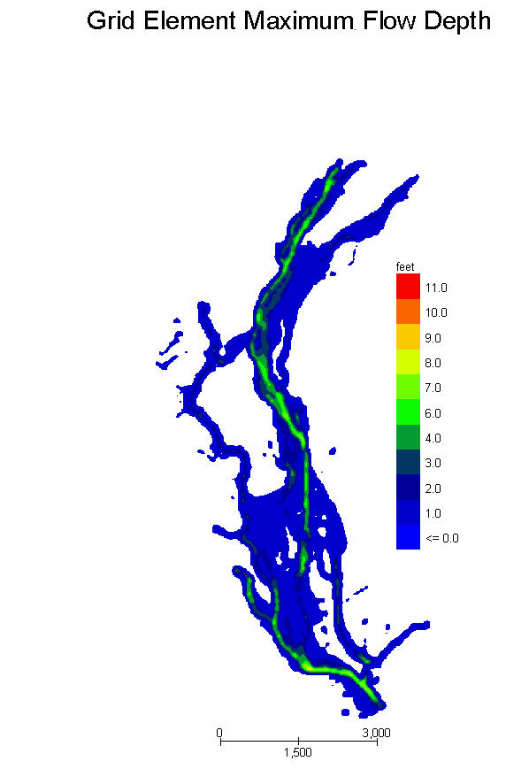
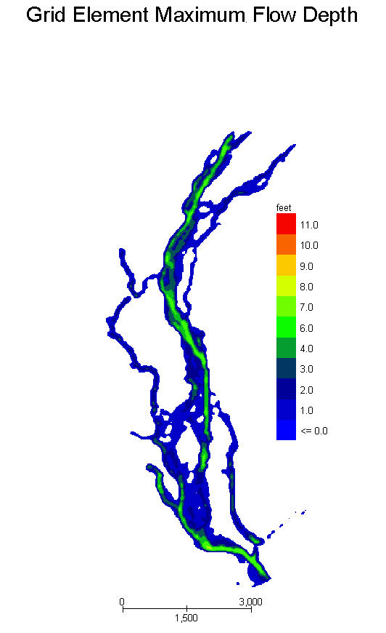
No Floodway
Floodway

Slide 12
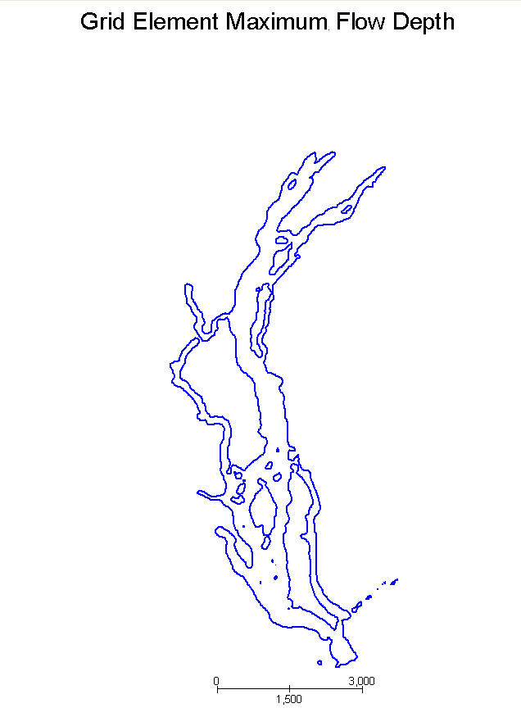
Floodway as a Line Plot

Slide 13
Example: Unconfined Flooding Associated with a Small Channel
Channel capacity is limited
Some reaches where overbank flood is dominant
Other reaches where channel conveys all the flooding

Slide 14
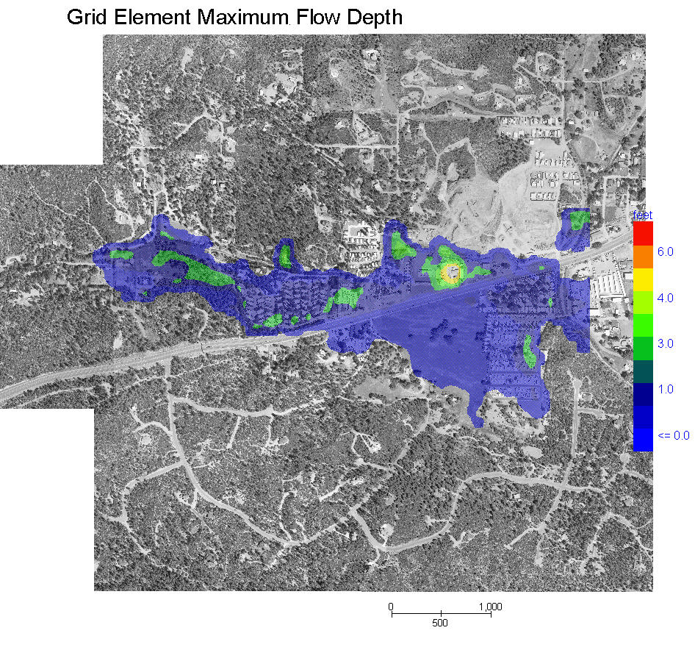
Channel Flooding - Area of Inundation
Floodplain Depths Only

Slide 15
Channel Flooding – Floodway Inundation
Floodplain Depths Only

Slide 16
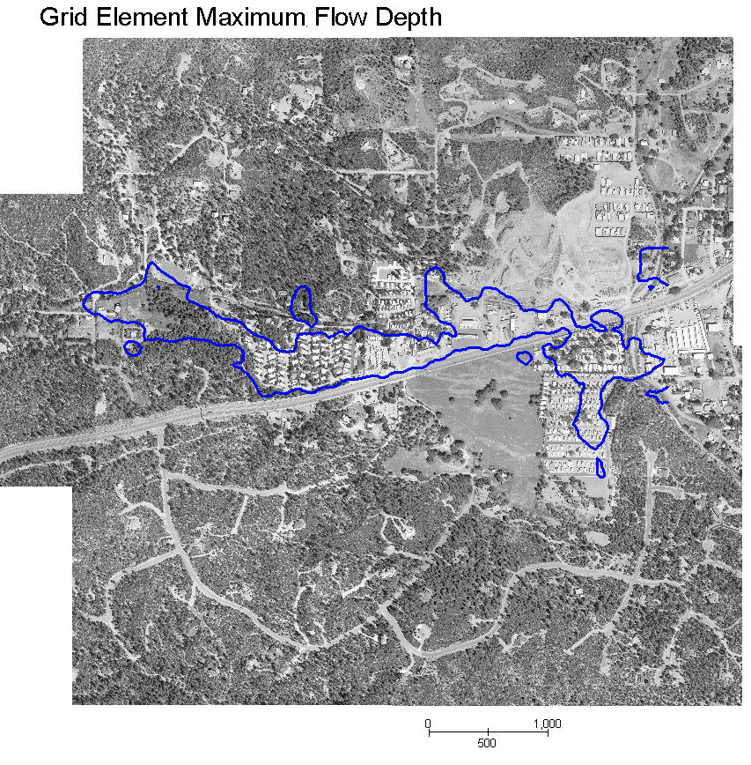
Channel Flooding – Floodway Delineation
Include this area as the floodway

Slide 17
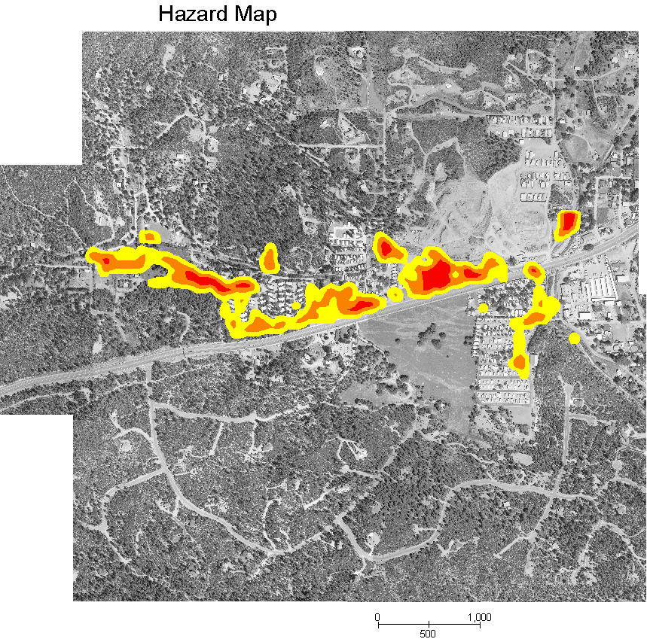
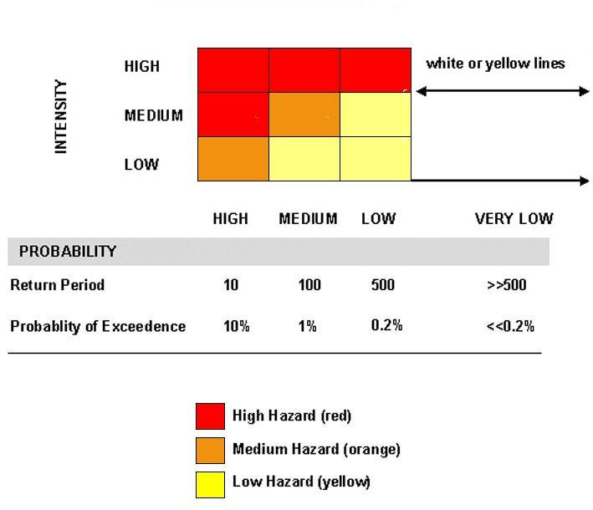
Risk/Hazard Map More Effective than Floodway Delineation

Slide 18
Recent Revision
Modified routine to identify flow direction when assigning the floodway elements.

Slide 19
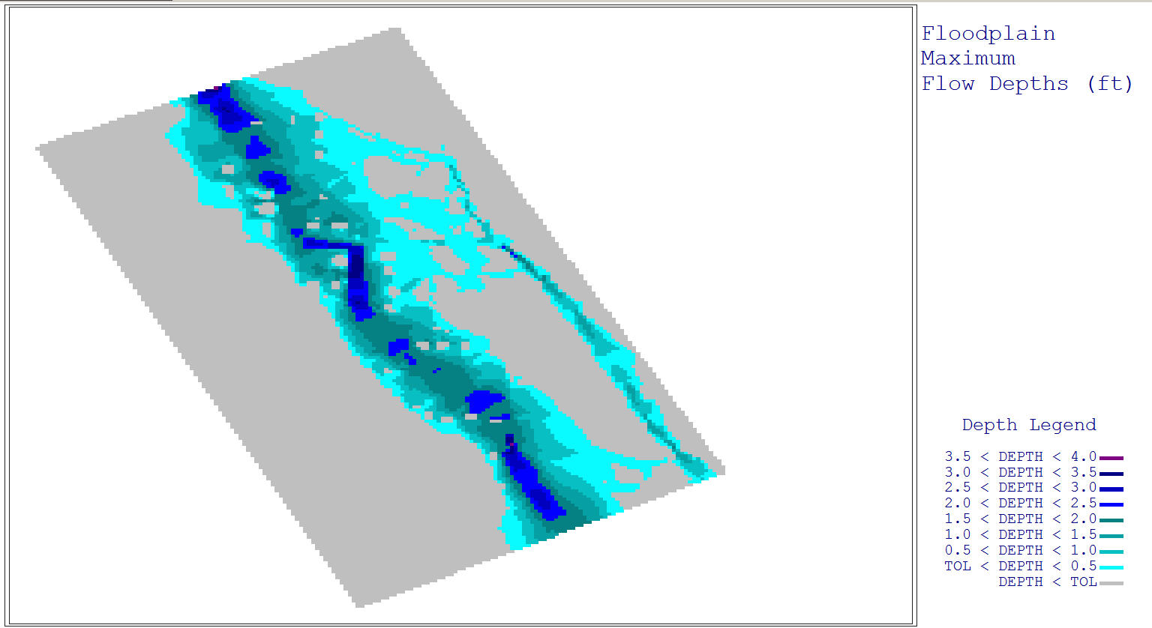
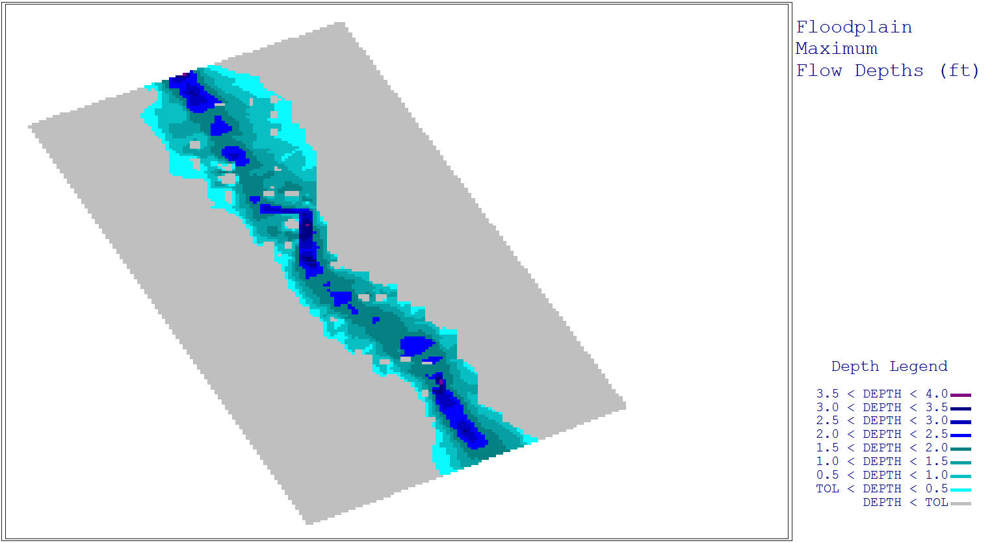
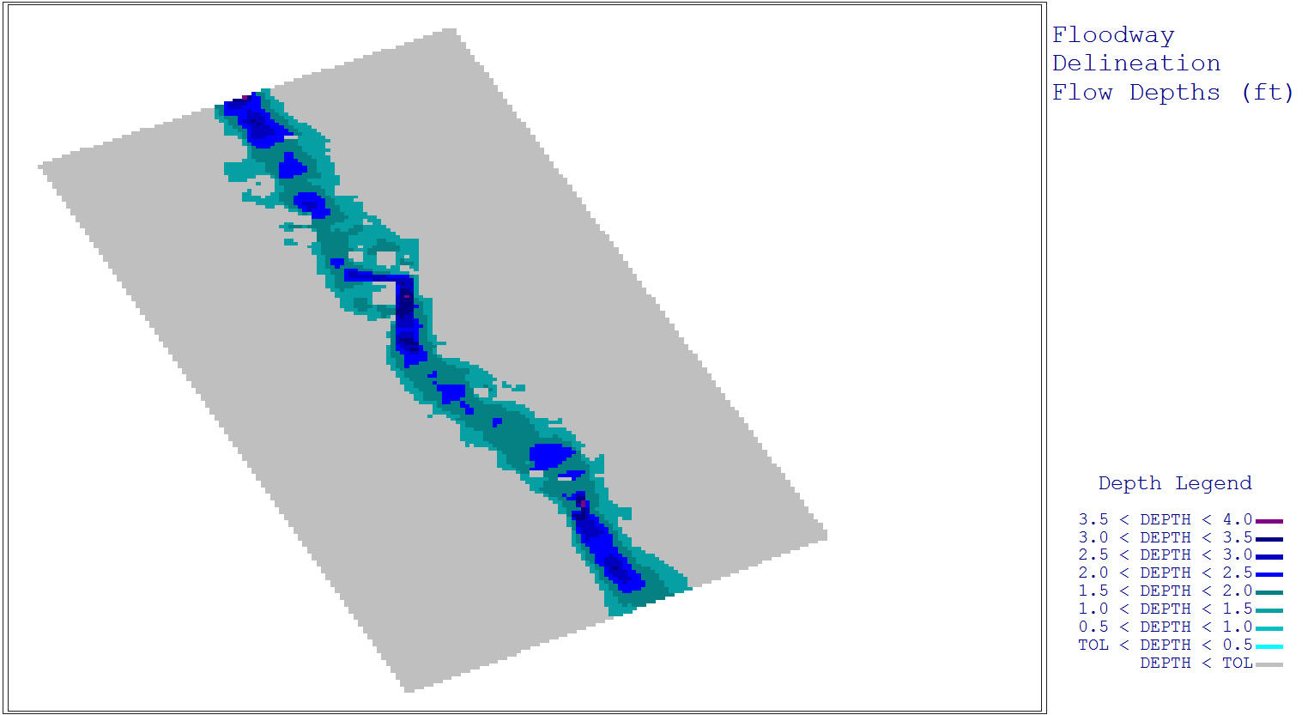
Maximum Flow Depths
Maximum Flow Depths with Floodway
Floodway

Slide 20
Concluding Remarks
Objective is to automate the Floodway Delineation
Some judgment is still required when outlining the final Floodway
In terms of no-build zones, a hazard delineation approach is more desirable.

